Slide 1
Hooks
State hooks
Effect hooks
Calling REST services
Annex
Class component techniques

Slide 2
Section 1: State Hooks
Recap component properties
Fixed properties vs. mutable state
State in a functional component
Complete example

Slide 3
Recap Component Properties
We've seen how to pass properties into a component
(Ditto for class components)
function Person({name, age, isWelsh, skills}) {
return ( … some elements … )
}
<Person name="John Evans"
age={21}
isWelsh={true}
skills={[…]} />

Slide 4
Fixed Properties vs. Mutable State
Properties are immutable
You can't change their values
What if the component needs to hold mutable state?
E.g. add items to an array, update a timestamp, etc.
You can achieve mutable state in a component
See following slides for details for functional components
(See Annex for details for class components)

Slide 5
State in a Functional Component
In a functional component, you use a "state hook"
To initialize state:
Call React.useState(initState),
Returns [stateVariable,updateFunc]
To access state:
Use stateVariable
To modify state
Call updateFunc(newState)
See example in stateSimple1.html

Slide 6

Complete Example
For a complete example of state management in a functional component, see:
stateComplete1.html

Slide 7
Section 2: Effect Hooks
Overview
Defining a simple effect hook
Effects with cleanup
Effect dependencies

Slide 8
Overview
A functional component can define effect hooks
An effect hook is effectively a call-back function
Called automatically by React, after each render
Enables the component to do some additional work
Note: Class components have a similar technique called lifecycle methods
See Annex for details

Slide 9
Defining a Simple Effect Hook (1 of 2)
To define an effect hook:
Call React.useEffect()
React calls your effect(s) after each render, including after the first render
Gives you an opportunity to perform side-effect work
React.useEffect(() => { side-effect code… })

Slide 10
Defining a Simple Effect Hook (2 of 2)
Example - see effectHooks1.html
Note:
You can define multiple effect hooks, which is good for separation of concerns
Effect hooks are invoked in the order defined

Slide 11
Effects with Cleanup (1 of 2)
Some effects might require cleanup
E.g. cancel a timer/interval
E.g. cancel a subscription to an external data source
To provide cleanup behaviour for an effect:
Return a function from the effect
React.useEffect(() => {
side-effect code…
return () => { cleanup code… }
})

Slide 12
Effects with Cleanup (2 of 2)
Example - see effectHooks2.html
React invokes an effect cleanup function as follows:
Before the component re-renders itself
Just before the component unmounts itself

Slide 13
Effect Dependencies (1 of 2)
React.useEffect() takes an optional 2nd argument
An array of dependencies
Effect will only be invoked if a dependency has changed
React.useEffect(() => {
side-effect code…
return () => { cleanup code… }
}, [dependency1, dependency2, … ] )

Slide 14
Effect Dependencies (2 of 2)
Example - see effectHooks3.html
Gallery has 4 effects, illustrating different scenarios:
Effect 1 - Called on every re-render
Effect 2 - Called on every thumbnail click
Effect 3 - Called on a different thumbnail click
Effect 4 - Called on initial render, cleaned up on unmount

Slide 15
Section 3: Calling REST Services
Overview
Starting the REST service
Testing the REST service
Calling the REST service

Slide 16
Overview
In this section we show a realistic example of why you’d implement an effect hook
The example will call a REST service at the point when a component is first rendered
The component calls the REST service asynchronously
When the REST service returns with the data, the component will re-render itself with the result data

Slide 17
Starting the REST Service
We’ve implemented the REST service in Node.js
Open a command window in the server folder
Run the following commands
The REST service starts up on port 3000
npm install
npm start

Slide 18
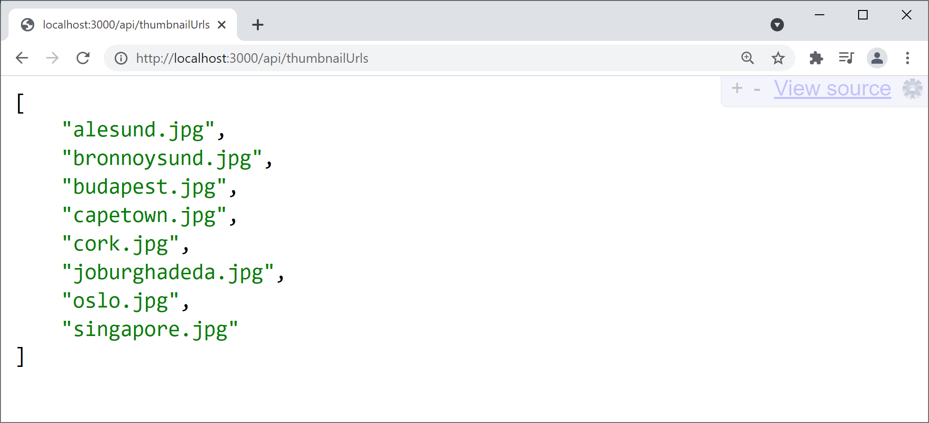
Testing the REST Service
To test the REST service is working, browse here:
http://localhost:3000/api/thumbnailUrls

Slide 19
Calling the REST Service
Now see restClient.html
After the Gallery component is first rendered:
Our effect hook makes an asynchronous REST call
When the REST call returns, we update component state
This causes the Gallery component to re-render
The example also shows how to use:
fetch(), async, await

Slide 20
Summary
State hooks
Effect hooks
Calling REST services

Slide 21
Annex: Class Component Techniques
State management
Overview of lifecycle methods
Lifecycle methods available
Implementing lifecycle methods
Optimizing UI updates
Is an update necessary?
Accessing previous state

Slide 22
State Management (1 of 2)
In a class component, state is available via this.state
To initialize state:
In the constructor, set this.state
To access state:
Use this.state
To modify state:
Call this.setState(state)
See example in stateSimple2.html

Slide 23
State Management (2 of 2)
For a complete example of state management in a class component, see:
stateComplete2.html

Slide 24
Overview of Lifecyle Methods
Class component have a technique called lifecycle methods
Quite similar to effect hooks for functional components
For a class component, React calls these methods:
Constructor
Lifecycle methods
render()

Slide 25
Lifecycle Methods Available
Here are the most common lifecycle methods that React calls upon a class component:
componentDidMount()
componentDidUpdate()
componentWillUnmount()
For a full list of lifecycle methods, see:
https://reactjs.org/docs/react-component.html

Slide 26
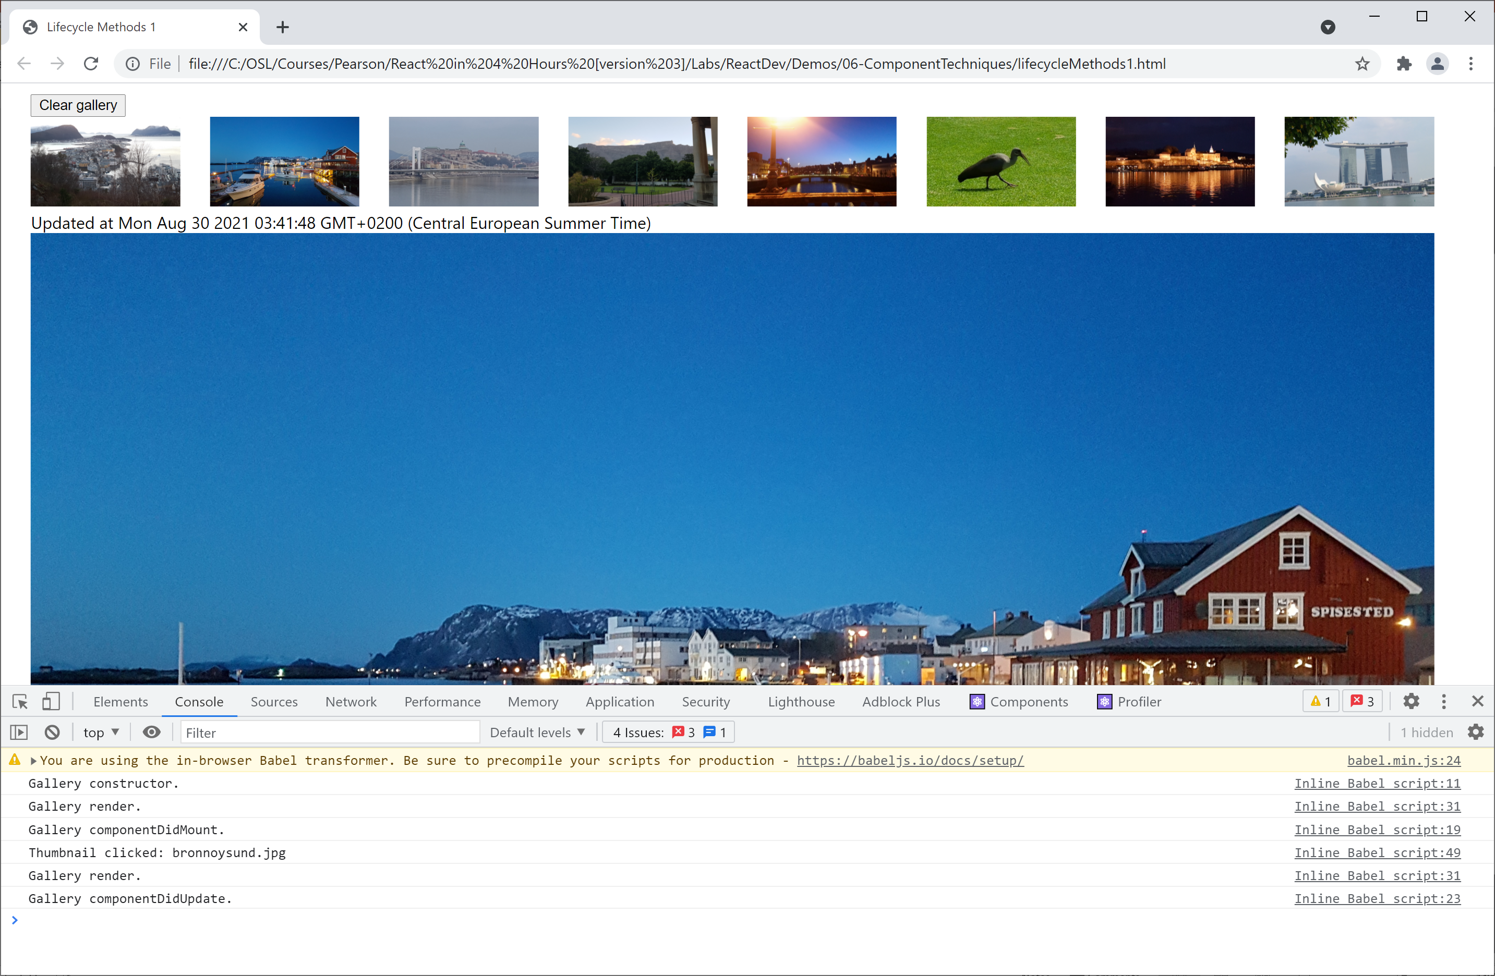
Implementing Lifecycle Methods
See the example in lifecycleMethods1.html
Displays info messages in the console

Slide 27
Optimizing UI Updates
Let's think about how we can optimize UI updates, to reduce the amount of re-rendering
At the moment, when the user clicks a thumbnail icon, it renders that icon in large format on the page
It does this even if you click the same thumbnail several times - what a waste of effort!
A better approach:
Only re-render if a different thumbnail is clicked

Slide 28
Is an Update Necessary?
Implement shouldComponentUpdate() method
The method receives the provisional new properties and state for the component
The function must return a boolean result
true if you want an update/render to happen
false if you decide there's no need to update/render
Example - see lifecycleMethods2.html

Slide 29
Accessing Previous State
Implement the componentDidUpdate() method
The method receives the previous properties and state for the component
What to do with this info?
E.g. stick it into some kind of "undo" store
E.g. log the change somewhere useful
Example - see lifecycleMethods3.html

